Slide 1
Prime programs
Programming Language Design and Implementation (4th Edition)
by T. Pratt and M. Zelkowitz
Prentice Hall, 2001
Section 8.3.3

Slide 2
Understanding control structures
Earlier discussion on control structures seemed somewhat ad hoc.
Is there a theory to describe control structures?
Do we have the right control structures?
Roy Maddux in 1975 developed the concept of a prime program as a mechanism for answering these questions.

Slide 3
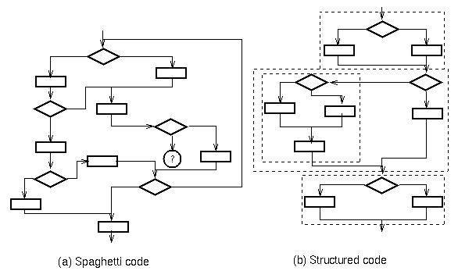
Spaghetti code

Slide 4
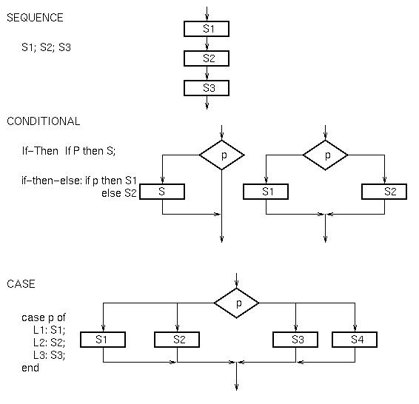
Control structures represented as flowcharts

Slide 5
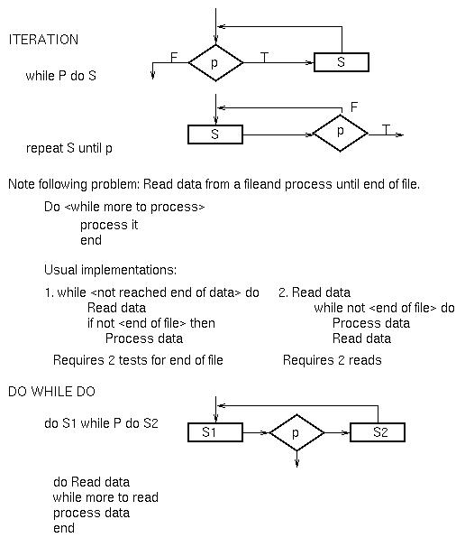

Slide 6
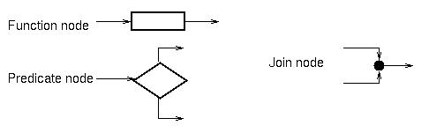
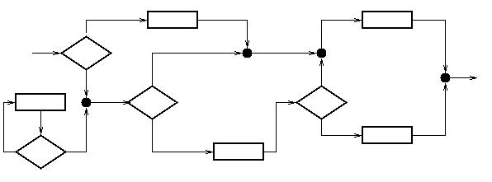
Theory of prime programs
Consider 3 classes of flowchart nodes:
Any flowchart is a graph of directed arcs and these 3 types of nodes:

Slide 7
Proper programs
A proper program is a flowchart with:
1 entry arc
1 exit arc
There is a path from entry arc to any node to exit arc
A prime program is a proper program which has no embedded proper subprogram of greater than 1 node. (i.e., cannot cut 2 arcs to extract a prime subprogram within it).
A composite program is a proper program that is not prime.

Slide 8
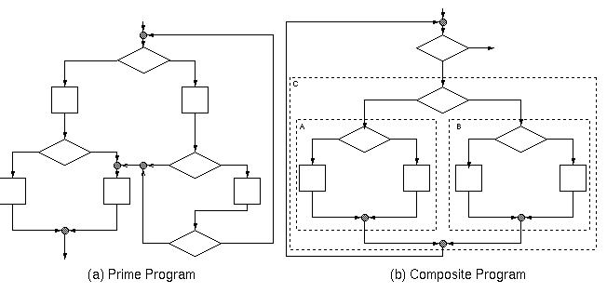
Prime flowcharts

Slide 9
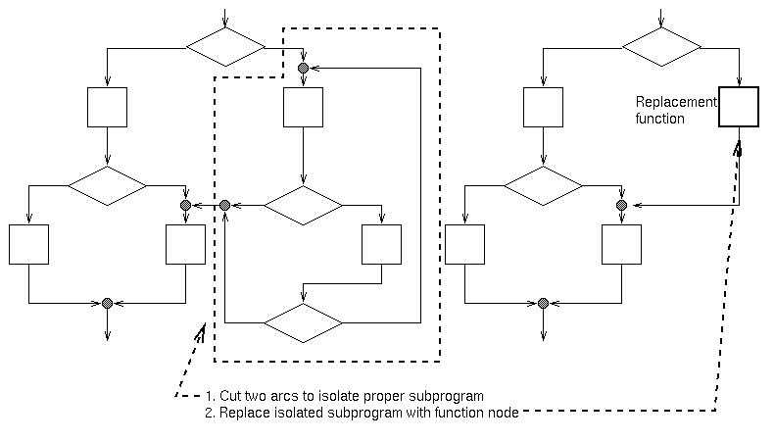
Prime decomposition
Every proper program can be decomposed into a hierarchical set of prime subprograms. This decomposition is unique (except for special case of linear sequences of function nodes).

Slide 10
All prime programs can be enumerated
All primes can be enumerated (next slide)
Each implements a function.
What is function for 2-node primes (c) and (d) and
4-node primes (l) through (q)?
All primes with at least 1 function node are our usual control structures - except (k) - the do-while-do construct. More about this later.

Slide 11
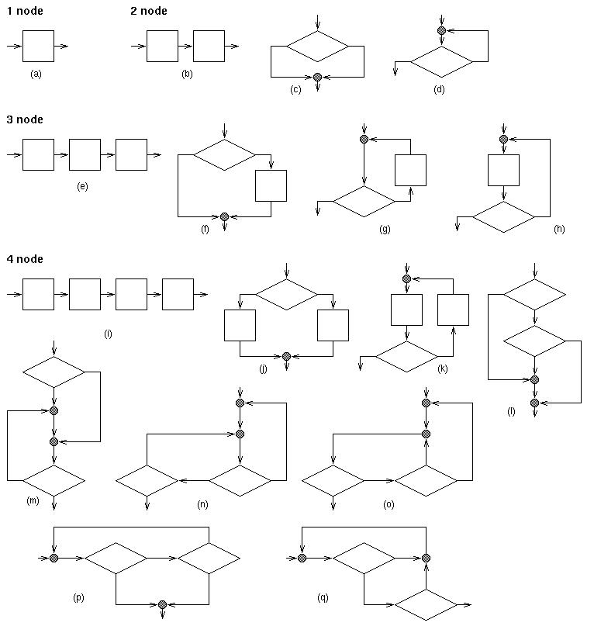

Slide 12
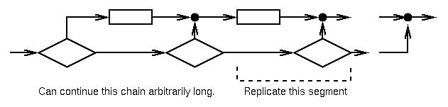
Number of primes is infinite
Construction to create primes with any number of nodes:
Use of prime programs to define structured programming:
Concept first used by Dijkstra in 1968 as gotoless programming.
Called structured programming in early 1970s-
Program only with if, while and sequence control structures.

Slide 13
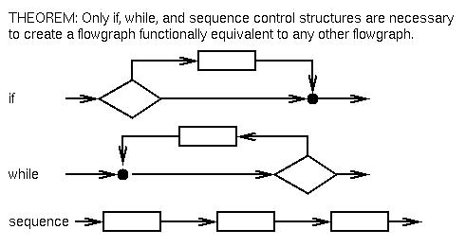
Structured programming
Issue in 1970s: Does this limit what programs can be written?
Resolved by Structure Theorem of Böhm-Jacobini.
Here is a graph version of theorem originally developed by Harlan Mills:

Slide 14
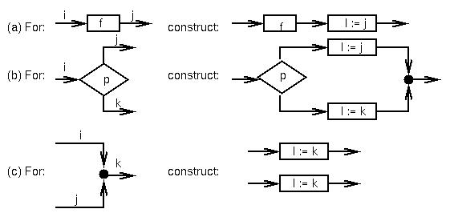
Structure theorem
Outline of proof:
1. Label each arc with 1 being the entry arc and 0 the exit arc.
2. Let I be a new variable not used in program.
3. For each node in program construct the following:

Slide 15
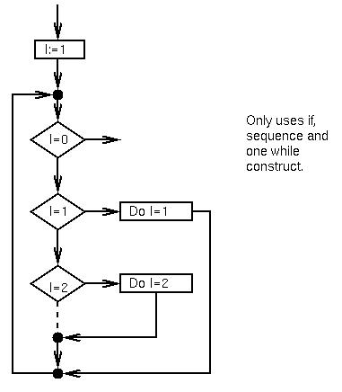
Structure theorem (continued)
4. Create the following new flowchart on right.
If F is the original function, what is the new function?

Slide 16
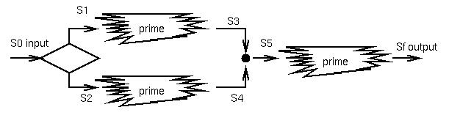
Program verification - again
For every flowchart, we can compute a function for each arc in its prime decomposition.
f1: S1 → S3;
f2: S2 → S4;
f3: S5 → Sf
A program is then C(f1, f2, f3): S0 → Sf
Program verification is a formal method to define these functions:
Axiomatic - Hoare, 1969
Weakest precondition - Dijkstra, 1972
Algebraic data types - Guttag, 1975
Functional correctness - Mills, 1975

Slide 17
Prime programs - Summary
Structure theorem does not say:
Given any “spaghetti program” convert it into a structured program.
What it does say is that there is no loss of functionality in using only those control structures. It is still up to the programmer to choose the best algorithm to solve problem.
Also, the prime decomposition shows that the primes up to 4 nodes are the useful programming language control structures, except for the do-while-do, which has been ignored by language designers.

